Slide 1


AIBridge
Lecture 2
Notes:
Hello everybody! Welcome back to lecture 2. (click)

Slide 2
Lecture Outline
I/O
List Manipulation
What is a function?
Built-ins
Importing
Notes:
In this lecture, we will be covering a couple major topics: input/output, list manipulation, and functions. Let’s dive on in.

Slide 3
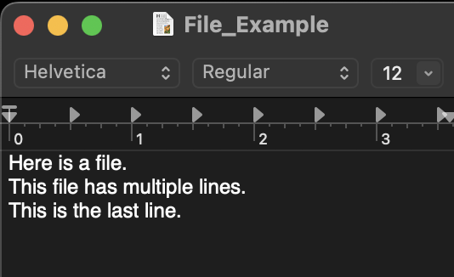
I/O
Standard Input
Input from console: input('prompt')
Open file: file_object=open(file, mode)
'r' is read and 'w' is write for the mode
read()
, readline()
, readlines()
Always close file: file_object.close()
"""Here is a file.
This file has multiple lines.
This is the last line."""
"Here is a file."
["Here is a file.",
"This file has multiple lines.",
"This is the last line."]
"This file has multiple lines."
"This is the last line."
Notes:
First, we can take input from what’s called the “console.” **click** On Google Colab, the console is right below a cell where code runs, with this type of input being taken there. However, the location of the console is different for each environment, so just be aware of that. Let’s go over to Google Colab to test this out! (stretch boundary so that Colab is larger) (demonstrate over in Colab)
Now, we don’t always want to be inputting like this into our code. Imagine doing that for thousands or even millions of numbers. Even with copying and pasting, that would be quite tedious. So how should we do this? Well, we can use python to read from a file. (click) Now we would want to use files because they’re commonly how data is stored. For example, you might want to get data from an xlsx spreadsheet for your code. In Python, we read from a file using the (click) “open” function. You also need to declare which mode you want to access the file in, which in this case, is (click) read mode. What the “file” refers to here is the path to the file, and we’ll get into that in a moment. There are several ways to read out of the file. First, we can use the (click) read function. This will output the contents of the file into a single multiline string, as you can see (click) here. You can also use (click) readline(), which will read only the next line into a (click) single string, then the next line (click), then the next (click), or (click) readlines(), which will read each line into its own separate string and then store the lines into a list (click).
Just to prove the utility of files to you, we’re going to go ahead and do a name activity! I want everyone to come up and write the first name you think of in this input (doesn’t necessarily have to be your name). Don’t worry about what the code does, just write one name and hit enter. And we’re going to time this, so make sure everyone gets in line quickly!
Now we’re going to compare that to how quickly it takes us to read in from a file.

Slide 4
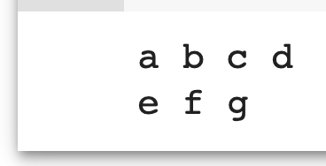
I/O
Standard Output
Output to Console: print(object1, object2, ...)
print('a', 'b', 'c', 'd')
print('e', 'f', 'g')
Open file: file_object=open(file, mode)
write()
Always close file
Note: This removes any existing file with that name
Notes:
Now with inputting comes outputting, and there are two main ways to do this as well. The first is the (click) print function, which like before corresponds to the console. You can add as many objects as you like to the print function, and all of them will be printed out one after another, separated by spaces.
For example, we might print something like this (click and describe, click again), or something like this (click and describe, click again).
As before, we can (click) write to files in a very similar way as we read from them, only instead of using the read() functions we will use the (click) write() function. There is only a single function to write luckily, and as always make sure you’re (click) closing the file! It’s also important to note that if you’re writing to a file that already exists, (click) any content previously in that file will be wiped out, so be careful with your file names.
Let’s go ahead and demo this in Colab!
strang = "Hello world"
file = open("file.txt", "w")
file.write(strang)
file.close()

Slide 5
Lecture Outline
I/O
List Manipulation
What is a function?
Built-ins
Importing
Notes:
Next, we’ll go ahead and talk a little bit more about lists.

Slide 6
List Manipulation
Indexing
List Operations
Listcomp
String/list Interop
Notes:
When you look at a list, there are 4 main categories of manipulations that we will need when we’re working with lists for ML: indexing, list operations, listcomps, and string/list interoperations.

Slide 7
List Manipulation
Indexing
[a, b, c, d, e]
0 1 2 3 4
-5 -4 -3 -2 -1
Single indexing
i
0
3
1
list_name[ ]
list_name[-2]
List slicing
list_name[ : ]
i j
1 4
Notes:
The first and most important concept we’ll talk about is with list indexing. Indexing is essentially akin to telling the computer which drink you want from a vending machine, only there’s often only one dimension and the thing you’re retrieving is the string, character, integer, or other item stored at that index, which is decidedly less tasty than, say, a Mountain Dew Code Red.
Anyhow, there are two main ways we use indexing as you can see here. You can call a (click) single index like (click) this, which notably starts at 0 if you’re counting forward and -1 if you’re counting backward (as in 0 items from the first, or the first item coming backwards).
For example, (click) this is the 0th index, (click) this is the 3rd index, and (click) this is the 1st. (click) You can index from the back of the list, like (click) this. (click)
You can also (click) slice the list (click) like this, which basically means you’re taking a continuous chunk out of the list. When you slice, you should remember that the first index is inclusive, while the second index isn’t (e.g. index 4 won’t be included in this slice here).
For example, (click and describe), (click and describe)

Slide 8
Self-Test
List Manipulation
Indexing
arr = [4, 5, 6, 101, 102, 103, 104, 105]
new_arr = arr[2:6]
print(new_arr)
What does the following code output?
A. [5, 6, 7, 101, 102, 103, 104, 105]
B. [6, 7, 101, 102, 103, 104, 105]
C. [6, 101, 102, 103, 104]
D. [6, 101, 102, 103]

Slide 9
Self-Test
List Manipulation
Indexing
arr = [4, 5, 6, 101, 102, 103, 104, 105]
new_arr = arr[2:6]
print(new_arr)
What does the following code output?
A. [5, 6, 7, 101, 102, 103, 104, 105]
B. [6, 7, 101, 102, 103, 104, 105]
C. [6, 101, 102, 103, 104]
D. [6, 101, 102, 103]

Slide 10

List Manipulation
Indexing
List Operations
Listcomp
String/list Interop

Slide 11
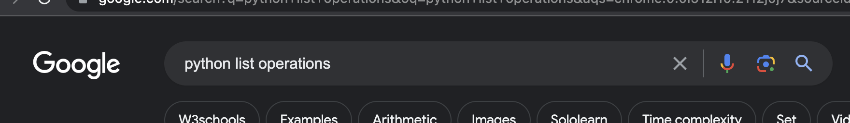
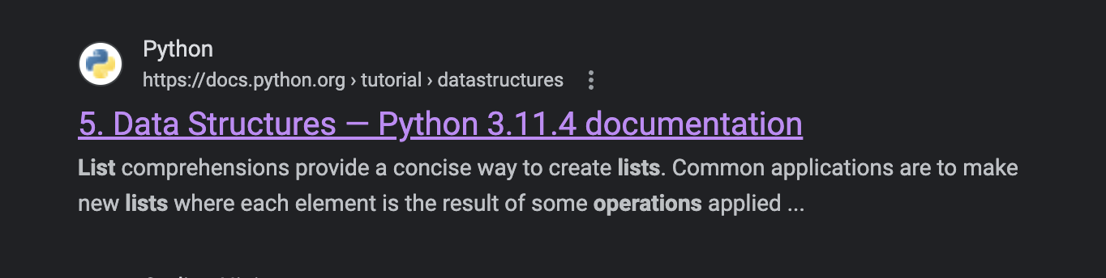
List Manipulation
List Operations
https://docs.python.org/3/tutorial/datastructures.html
1
2
Notes:
Before we get into the actual functions themselves, we will point out that you can find a comprehensive list of all of the functions here: (click). If you’d like, you can also (click) search up “python list operations” and then (click) click on this link here.
As you can see when you go into the link, there exists a rather large number of functions that you can use with lists. This is perhaps one of the most relevant examples of the importance of documentation, as memorizing this extremely large list would be very tedious and difficult. Instead, it’s much easier to simply look through the documentation to find the function that you need and to make sure that you’re using it right. With that being said, let’s go ahead and take a look at a couple of the most relevant list operations.

Slide 12
List Manipulation
List Operations
my_list =
[3, 14, 0, -2, 5
]
Notes:
Say we have this list here: (for each of these slides, get people to stand up and demonstrate)

Slide 13
List Manipulation
List Operations
append()
[3, 14, 0, -2, 5
]
my_list.append(19)
19
Notes:
The first thing we can do is to add, or (click) append, new elements to the end of the list.

Slide 14
List Manipulation
List Operations
append()
[3, 14, 0, -2, 5, 19
,
19
[3, 14, 0, -2, 5
]
my_list.append(19)
8
my_list.append( )
my_list.append(8)
Notes:
For example, we might add 19 like this, then (click)

Slide 15
List Manipulation
List Operations
append()
[3, 14, 0, -2, 5, 19
[3, 14, 0, -2, 5, 19, 8]
,
8
]
my_list.append(19)
my_list.append(8)
Notes:
8 like this… (click)

Slide 16
List Manipulation
List Operations
remove()
-2,
5, 19, 8]
[3, 14, 0, -2, 5, 19, 8]
[3, 14, 0,
my_list.remove(-2)
Notes:
It’s also possible to remove items if we wanted to. For example, we can take out -2 like this (click). The remove function will then (click) search for the first occurrence of the element we want to remove, and remove it.

Slide 17
List Manipulation
List Operations
remove()
5, 19, 8]
[3, 14, 0, 5,
19,
8]
[3, 14, 0,
my_list.remove(-2)
my_list.remove(19)
Notes:
And then 19 like this…

Slide 18
List Manipulation
List Operations
remove()
[3, 14, 0, 5,
[3, 14, 0, 5, 8]
8]
my_list.remove(-2)
my_list.remove(19)

Slide 19
List Manipulation
List Operations
pop()
1
,
14, 5, 8]
[3, 14, 0,
1,
my_list.pop(3)
Notes:
There’s also a variation of remove that’s known as pop. The only major difference between remove and (click) pop is that remove doesn’t return anything, while pop will return the value at the index that was just “popped” from the list.

Slide 20
List Manipulation
List Operations
pop()
[3, 14, 0,
14
,
5, 8]
14, 5, 8]
1
my_list.pop(3)
my_list.pop(3)
Notes:
So here, if we pop index 3, we’ll get 1. If we do it again…

Slide 21
List Manipulation
List Operations
pop()
[3, 14, 0, 5, 8]
[3, 14, 0,
5, 8]
1
my_list.pop(3)
my_list.pop(3)
14
Notes:
We’ll get 14.

Slide 22
List Manipulation
List Operations
+
]
[3, 14, 0, 5, 8
[3, 14, 0, 5, 8]
my_list_2 = [10, 9, 8, 7]
my_list_2 = [
10, 9, 8, 7]
my_list = my_list + my_list_2
Notes:
Another thing we can do with lists is addition, where adding any two lists will simply append all of the elements of the second list to the first.
So say we have this other list (click) my_list_2. Then, if we want to append the whole list to the end of my_list, we can do something like (click) this.

Slide 23
List Manipulation
List Operations
+
[3, 14, 0, 5, 8
10, 9, 8, 7]
,
my_list_2 = [10, 9, 8, 7]
my_list = my_list + my_list_2
Notes:
So this is what happens if we add my_list and my_list_2 and then assign it back to my_list.

Slide 24
List Manipulation
List Operations
len()
[0, 3, 5, 7, 8, 8, 9, 10, 14]
len(my_list)
9
Notes:
The last few functions are more utility functions that describe the list, and they include (click) len(), which gives you the (click) length of the list

Slide 25
List Manipulation
List Operations
max()
[0, 3, 5, 7, 8, 8, 9, 10, 14]
max(my_list)
14
Notes:
(click) max, which returns the (click) max value

Slide 26
List Manipulation
List Operations
min()
[0, 3, 5, 7, 8, 8, 9, 10, 14]
min(my_list)
0
Notes:
and (click) min, which returns the (click) min value

Slide 27
List Manipulation
Indexing
List Operations
Listcomp
String/list Interop

Slide 28
List Manipulation
Listcomp
Shorthand for “for” loops
new_list = [expression for object in iteration]
[obj1, obj2, obj3, obj4, obj5, obj6, obj7 ...]
[new1, new2, new3, new4, new5, new6, new7 ...]
expression
Notes:
For even cleaner code that uses less lines, you can consider using list comprehension, which is basically like (click) a shorthand for a “for” loop. Usually, you want to use them when you generate a new list based on an existing list, string, or range, and when you want to (click) (click) iterate an expression for every object in a list kind of like this.

Slide 29
List Manipulation
Listcomp
new_list = [(i+1)/2 for i in range(7)]
[0, 1, 2, 3, 4, 5, 6]
[0.5, 1.0, 1.5, 2.0, 2.5, 3.0, 3.5]
(i+1)/2
Notes:
For example, (click) this code is saying for each of the 7 elements in the list, add one to it and then divide it by 2 and assign it to the corresponding value here. We can visualise it like this: (click) (click)
Before we move on, can everyone take a couple minutes to go ahead and “translate” the list comprehension into a traditional for-loop?

Slide 30
List Manipulation
Indexing
List Operations
Listcomp
String/list Interop
Notes:
The last thing that we need to think about is String/list Interoperations.

Slide 31
List Manipulation
String/list Interop
join()
List of strings
str3
my_list = [str1, str2, str3]
str1
str2
separator
separator
separator.join(my_list)
Notes:
Say you have a (click) list of strings like (click) this. There exists a special function, known as (click) join(), which can take a separator and append all of the strings back-to-back, separated by the separator, something like (click) this. This is again more or less a utility function that saves you from having to write a for loop.

Slide 32
List Manipulation
String/list Interop
join()
List of strings
my_list = [str1, str2, str3]
separator.join(my_list)
Final String
str1
separator
str2
separator
str3
Notes:
Once we run this code, the resulting string will look something like (click) this here.

Slide 33
List Manipulation
String/list Interop
join()
"Hello,"
"my"
"name"
"is"
"Bob!"
my_list = ["Hello,", "my", "name", "is", "Bob!"]
' '
' '.join(my_list)
' '
' '
' '
Notes:
If we want to look at an actual example, we can take this for example:
(click and describe)

Slide 34
List Manipulation
String/list Interop
join()
my_list = ["Hello,", "my", "name", "is", "Bob!"]
' '.join(my_list)
' '
' '
' '
"my"
"name"
"is"
"Bob!"
"Hello, my name is Bob!"
' '
"Hello,"
Notes:
We can see each string will be combined together, with a space between each.

Slide 35
Lecture Outline
I/O
List Manipulation
What is a function?
Built-ins
Importing
Notes:
Our final topic here is functions.

Slide 36
What is a function?
Function
Input
Output
Notes:
In essence, (click) functions are some sort of code block that takes in an (click) input and (click) (click) (click) then spits out an output after performing some code on the input.

Slide 37
What is a function?
Args and Kwargs
Normal arguments are based on position (nth input mapped to nth argument)
Kwargs (keyword arguments) are assigned
Notes:
There’s also a note to be made about two particular parts of the function input: arguments and keyword arguments. Arguments are essentially anything that is passed into the function, that is, any piece of content that’s contained within the parentheses of the function. Each input will be assigned, based on position, to the corresponding argument. In comparison, keyword arguments are arguments that are assigned to a particular keyword, and aren’t necessarily positionally oriented in the function’s input.

Slide 38
What is a function?
Arguments
They are positional
Can have defaults
def my_function(arg_1=-1, arg_2=-1, arg_3=-1, arg_4=-1):
print(arg_1, arg_2, arg_3, arg_4)
my_function(1,2,3,4)
my_function(3,4)
Notes:
Let’s take a look at an example of arguments first. As a reminder, arguments are considered positional, and by that token it also means that if there aren’t enough inputs passed in, then arguments that aren’t assigned will default to a given default value.
(go into Colab to prove it to everyone)
If we have this function that we defined here, then what do we think the first function call will print out? Right! It’ll print out “1 2 3 4”, since arg_1 will correspond to 1, arg_2 to 2, arg_3 to 3, and arg_4 to 4.
What about the second case? Well, it’ll actually print out “3 4 -1 -1”. This is because arg_3 and arg_4 aren’t assigned, so they will use the default values they were assigned in the function definition at first.

Slide 39
What is a function?
Keyword Arguments
You can specify a specific argument instead of relying on positions (helpful when there are a lot of arguments and you only need a few)
def my_function(a,b,c,d):
print(a,b,c,d)
my_function(b=2,c=3,d=4,a=1)
Notes:
Now, keyword arguments. Remember that keyword arguments are arguments that you specify, as opposed to relying on the positions. This generally occurs when you’re using only a specific subset of a large number of possible arguments, or if you’re calling the arguments out of order.
(go into Colab to demonstrate)
Can anyone tell me what the following code prints out? Exactly! It will print out “1 2 3 4”, as this is what value each of the variables now correspond to.

Slide 40
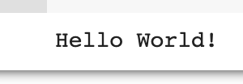
What is a function?
print()
Print
"Hello world!"
Notes:
One last example about functions before we move on: let’s take a look back at (click) the print function. In this case, the print function takes some sort of input, for example this (click) “Hello world!” string. It will then (click) (click) (click) output the same input to the console.

Slide 41
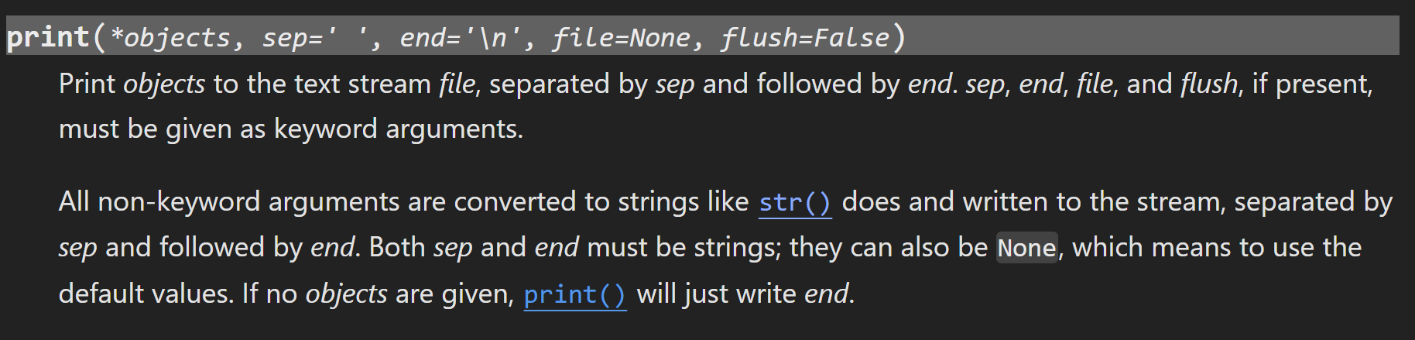
What is a function?
Args and Kwargs
Notes:
But exactly how does the print function know what to print? And why does it have some of the behaviours we outlined before, about printing specific objects separated by spaces, or ending with a new line every single time? Well, we can look at the documentation here to find out. In particular, we see here that “all non-keyword arguments are converted to strings and written to the stream, separated by sep and followed by end.” This essentially tells us all we need to know.
Thus, we can see that if we want to modify the behaviour of print, we have to use keyword arguments to specify that we’re changing the separator or end.
(go into Colab to demo changing the separator and the end)

Slide 42
Lecture Outline
I/O
List Manipulation
What is a function?
Built-ins
Importing
Notes:
In this lecture, we will be covering two main things: input and output, and list manipulation. Don’t think you got off easy yet with just these two topics, as these are some quite complicated and tough topics. Let’s dive on in.

Slide 43
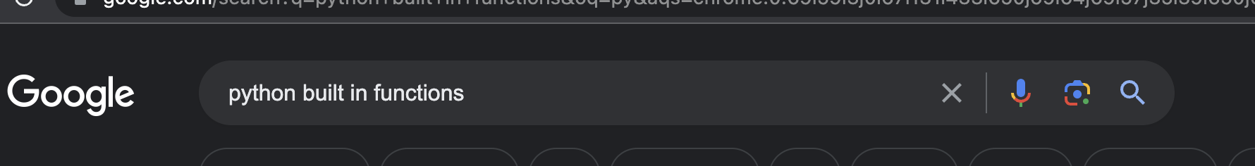
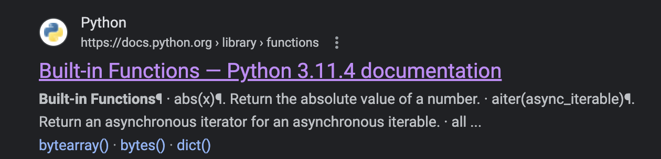
Built-ins
https://docs.python.org/3/library/functions.html
1
2
Notes:
Some of the most common functions can be found (click) here, in the Python documentation once again. These functions are known as “built-ins”, and if you ever need to refer to the documentation about any of them, you can (click) search up “python built in functions” and then go ahead to (click) this link to find the documentation.
Once again, it’s extremely important to get used to this process of referring to the documentation. It is nearly impossible to memorise every single built-in function, and often you’ll get bugs that you don’t quite understand because of something hidden deeper in the documentation, even if you know what the function does.

Slide 44
Lecture Outline
I/O
List Manipulation
What is a function?
Built-ins
Importing

Slide 45


Importing
Burp
Python
Module
Notes:
Outside of the built-ins, we can also import functions from libraries outside (click) the base Python library. You can think of importing as something like this, where we grab a (click) module and (click) feed it into Python, allowing (click) Python to have access to all of its packages.
Importing is particularly important because we don’t want to reinvent the wheel. Other people have already heavily optimized and published modules and functions and we can build up from that foundation. There are three main ways to import a function…

Slide 46
Importing
import sklearn
from sklearn import linear_model
import pandas as pd
Notes:
Firstly, you can simply (click) import the whole package, for example what we’re doing here with sklearn. This brings in all of the functions within the sklearn package.
You can also (click) import a specific function or set of functions by doing this. In essence, you’re saying you want to take in this specific set of functions from this specific package.
Finally, if you want to alias the package name as something different, you can use the “as” keyword and do something like (click) this.

Slide 47
Importing
import sklearn
from sklearn import linear_model
import pandas as pd
To find functions we might want to use, we need to look at the documentation, for example:
https://pandas.pydata.org/docs/
Notes:
Highlight the importance of looking at documentation, and mention that we’ll go over this in lab a bit more with specific functions.

Slide 48
That was a lot!
Let’s get to the lab!
Notes:
Let’s get to the lab

